Slide 1

Control Structures: Iteration
Week 5 Hybrid Session 2

Slide 2
5.7: Nesting with Loops
Recap: what is nesting?
Nesting Options:
if statement within an if statement
if statement within a loop
Loop within a loop
Loop within an if statement

Slide 3

Demo
Loop within a Loop

Slide 4
How it works…
i = 0;
j = 0
j = 1
j = 2
j = 3
j = 4
i = 1;
j = 0
j = 1
j = 2
j = 3
j = 4
i = 2;
j = 0
j = 1
j = 2
j = 3
j = 4
i = 3;
j = 0
j = 1
j = 2
j = 3
j = 4

Slide 5

Demo
if within a loop

Slide 6
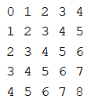
Your Turn
Practice 1:
Using a nested loop, write a function which will print the following square:
Practice 2:
Using an if statement nested within a loop, write a function which outputs every third letter of a word which is entered by the user.

Slide 7
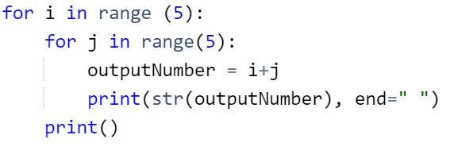
Solution 1

Slide 8
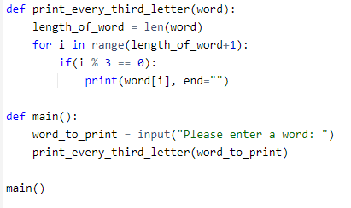
Solution 2

Slide 9

5.8: Your Challenge
In the sessions last week we talked through an example where the person enters a number. The program then outputs whether it is even/odd and divisible by 3
What happens if the person doesn’t enter a number?
Write a function called get_input() which asks the user to enter a number. It will keep asking until they enter a number.

Slide 10
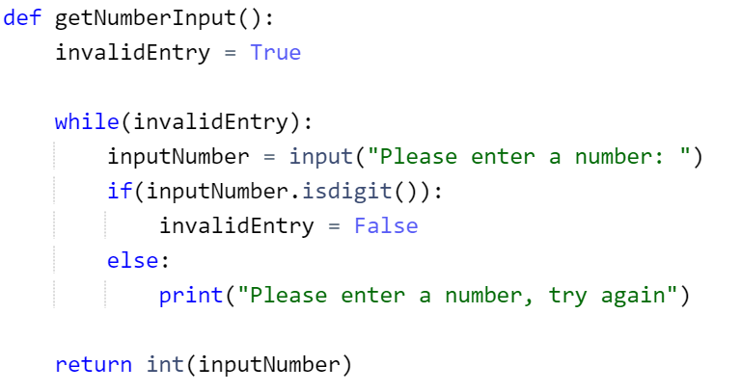
Solution

Slide 11
5.9: Break
Used to exit a loop
Often used in conjunction with while True: loops

Slide 12

Demo
Using the break keyword

Slide 13
Continue
Tells the program to jump back to the beginning of the loop
Ignores everything which is after the continue

Slide 14

Demo
Using the continue keyword

Slide 15
5.10: Which Iteration Technique Do I Choose?
Iterating through a list?
Fixed number of iterations?
Carry out at least once?
No
No
No
While
Yes
Yes
Yes
For-Each
For
Do-While
Warning: not all languages have
a do-while loop

Slide 16
Summary of This Week
To investigate the different types of iteration within Programming
To experiment with and understand the range() function
To implement Python programs which make use of the for loop
To understand the use of the for-each loop in Python
To use the while loop to implement iteration in Python
To demonstrate the use of nesting with loops (with other loops and other control structures)
To explore the use of nesting to validate user input
To appreciate the use of break and continue within loops

Slide 17
Next Week – Algorithmic Thinking
Pre-Session
What is an algorithm?
Complexity
Benefits and Drawbacks of Algorithmic Planning
Hybrid Session 1
Flowcharts
Using Flowcharts to Design Algorithms
Hybrid Session 2
Converting Flowcharts to Functioning Code
Flowcharts and Programs for Different Types of Problem

